Slide 1


RESUME CLASSIFICATION
Team members:
1.) Ms. Suraksha Ashokbhai Patel
2.) Ms. Nikita Sunil Chavan
3.) Mr. Bharat Patil
4.) Ms. Ananya Biswas
5.) Mr. ABHISHEK KUMAR SAHU ERE
6.) Mr. CHITTALURI KARTHIK
7.) Ms. Shaik Nusrath
Mentor Name: Mr. Saurabh Singh

Slide 2
The document classification solution should significantly reduce the manual human effort in the HRM .It should achieve a higher level of accuracy and automation with minimal human intervention.
Business Objective

Slide 3
PROJECT ARCHITECTURE
Collection of Data
Business Understanding
Exploratory Data Analysis(EDA)
Deployment
Model Building

Slide 4
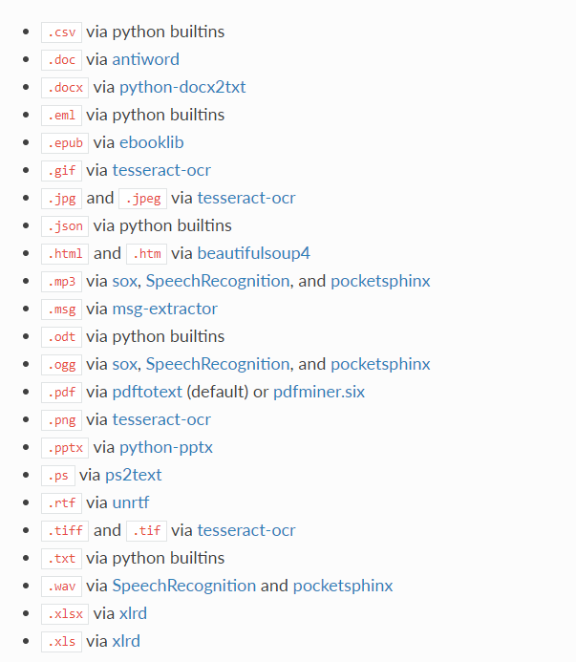
Textract
This package provides a single interface for extracting content from any type of file, without any irrelevant markup.

Slide 5
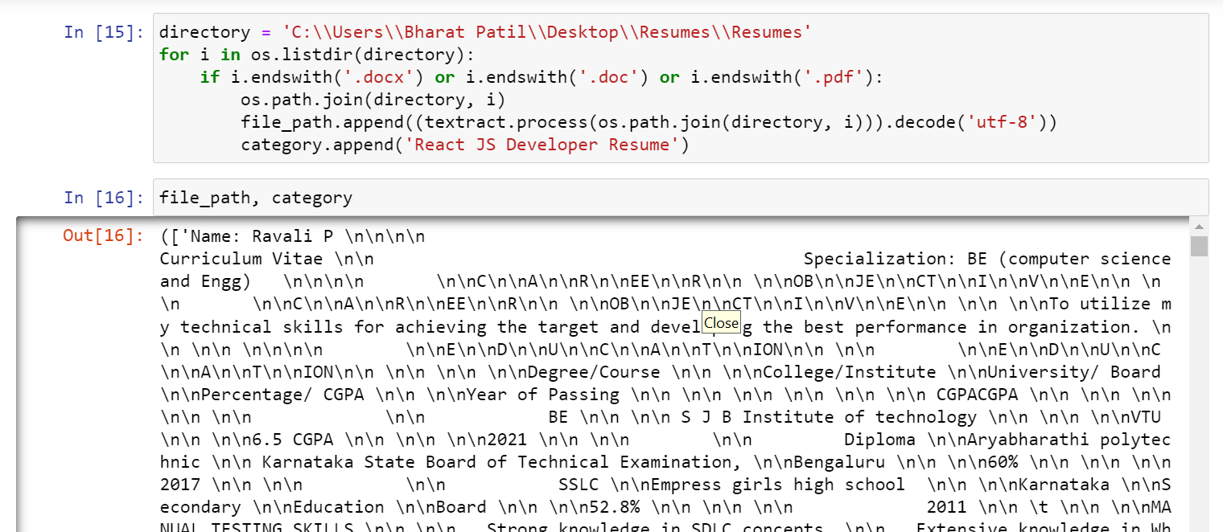
Converting all file to .txt (Process)

Slide 6
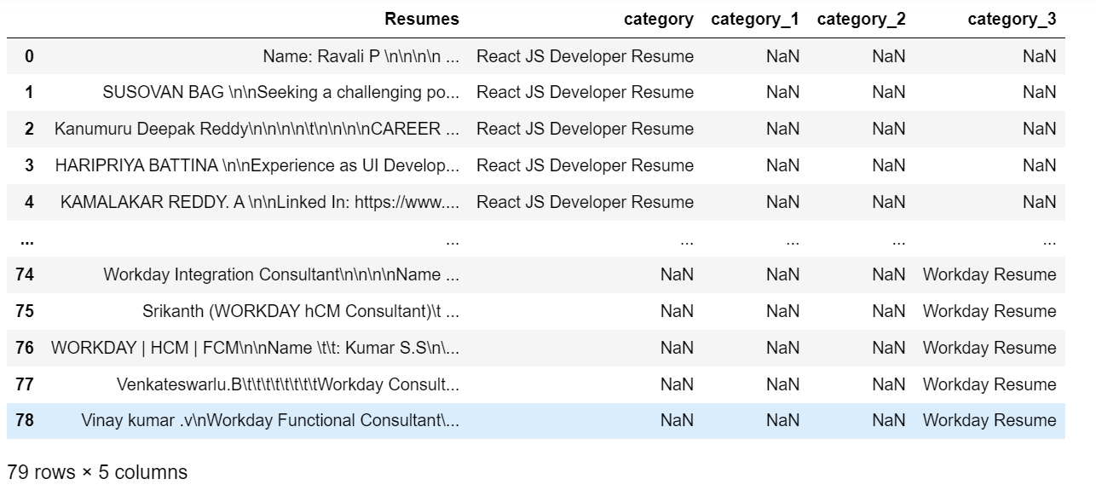
Merging all category files.

Slide 7
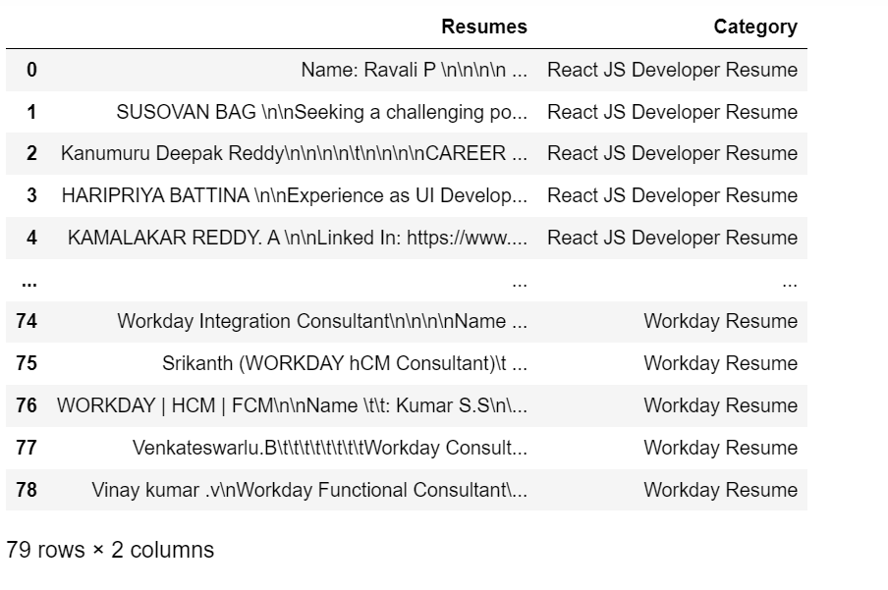
Converting text to .csv (Process)

Slide 8
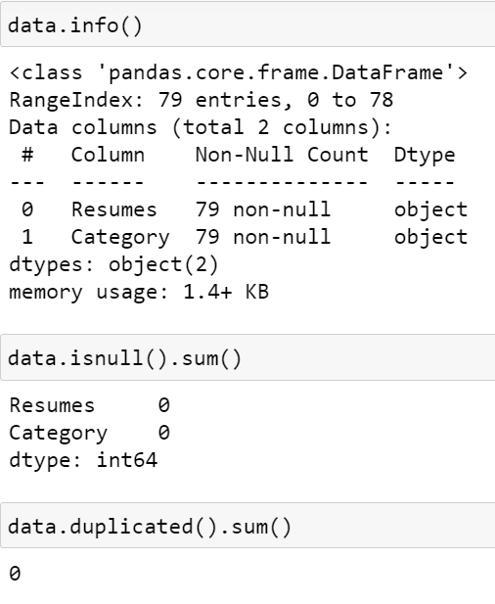
Data Set Details
After Extracting and Modifying the Dataset, given data contains a total of 4 Classes and 79 rows .

Slide 9
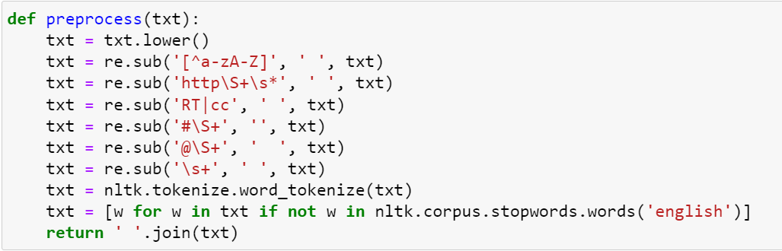
Removing All Unwanted Character’s
Unwanted Character’s like - \n \t, http links, tags, hashtags, html tags, converting to lower case, removing white spaces etc.
Word Tokenization - Tokenization is essentially splitting a phrase, sentence, paragraph, or an entire text document into smaller units, such as individual words or terms. Each of these smaller units are called tokens.
Removing Stop-words - A stop word is a commonly used word (such as “the”, “a”, “an”, “in”) that a search engine has been programmed to ignore, both when indexing entries for searching and when retrieving them as the result of a search query.

Slide 10
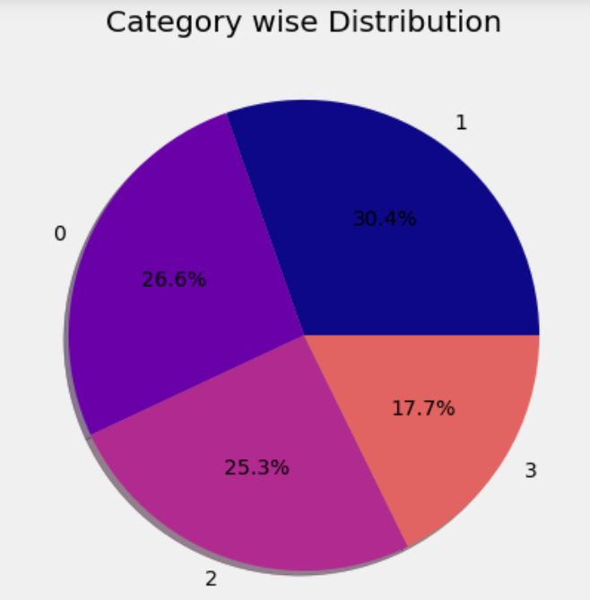
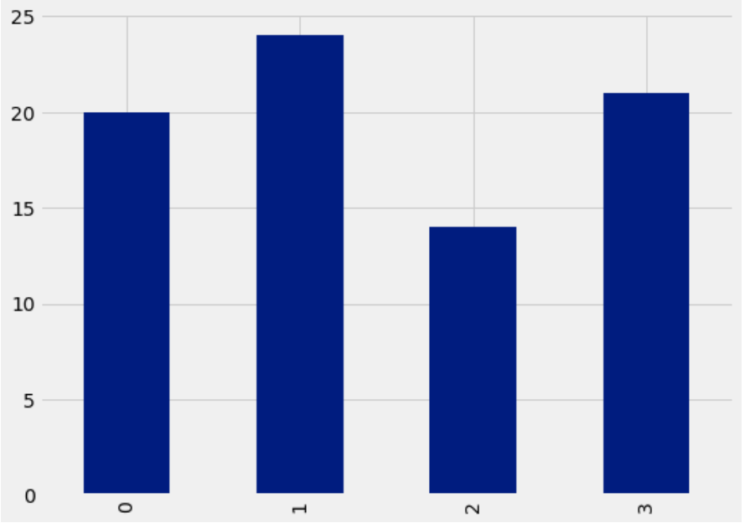
Labels
By using Pie chart roles applied feature is displayed to visualize the job roles.
By using Histogram roles applied feature is displayed to check the job types.

Slide 11
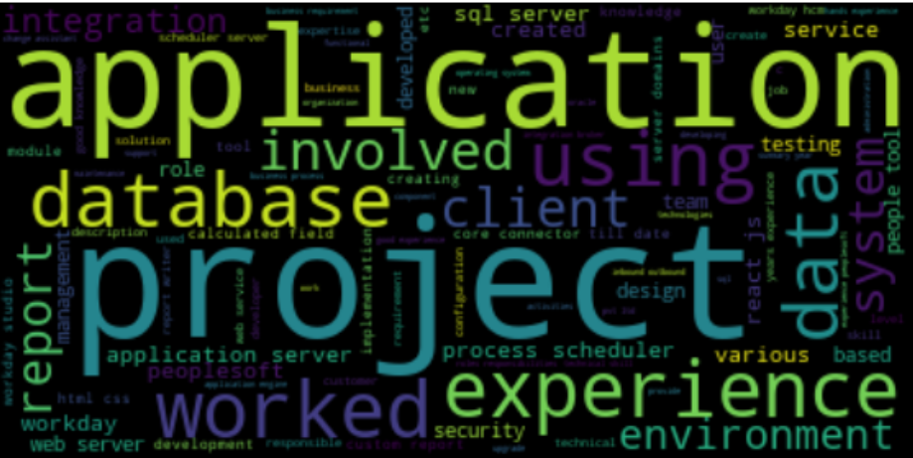
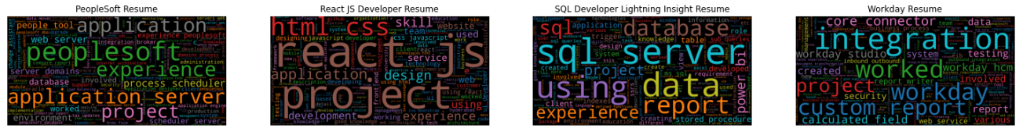
Word cloud

Slide 12
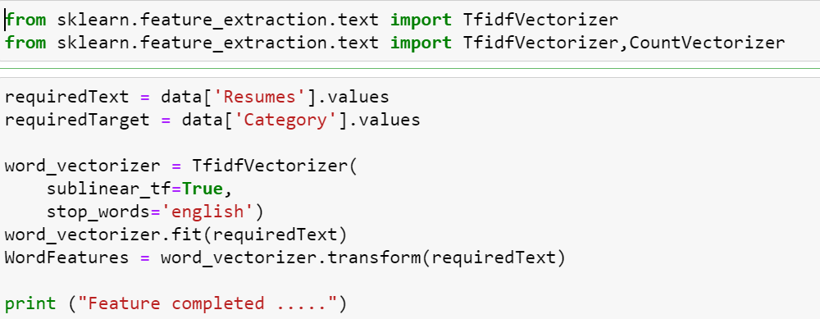
TF-IDF
TF-IDF is better than Count Vectorizers because it not only focuses on the frequency of words present in the corpus but also provides the importance of the words.
We can then remove the words that are less important for analysis, hence making the model building less complex by reducing the input dimensions.

Slide 13
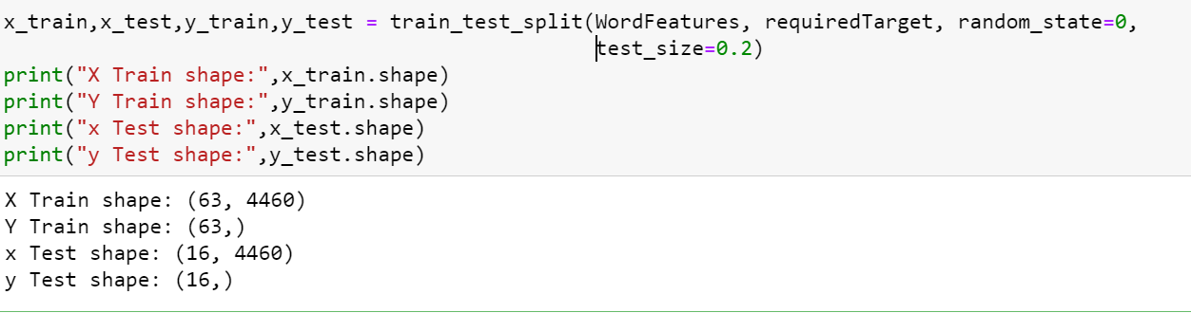
Train-Test Split
4
5
3
4

Slide 14
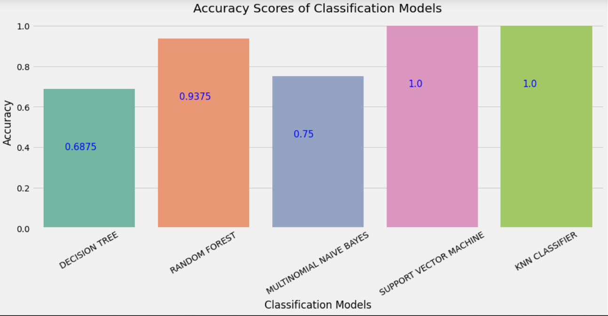
Model - Building

Slide 15
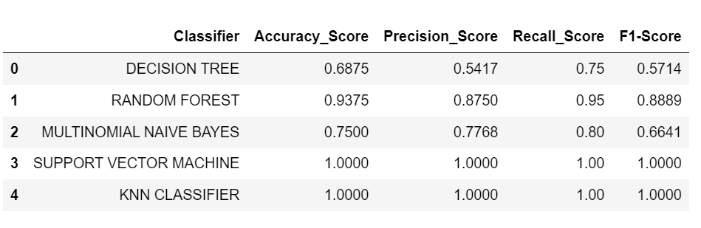
Model- Evaluation
Here, we have taken Model building algorithms such as Decision Tree, Random Forest, Naive Bayes, SVM, KNN Classifier.
Among these algorithms, 100% Accuracy, Precision, Recall and F1-score have been achieved.
100% accuracy is achieved by using the Support Vector Machine (SVM), KNN Classifier.

Slide 16
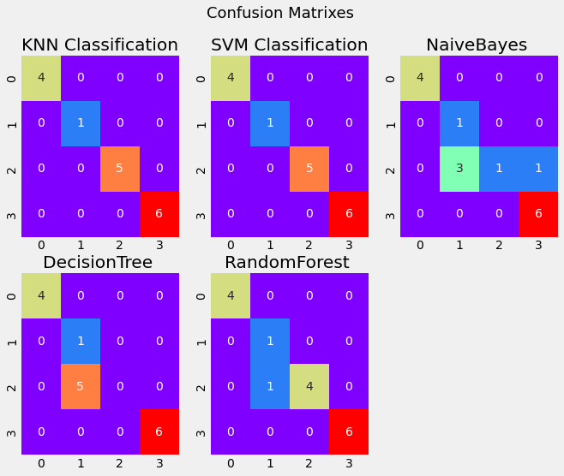
Model-Evaluation
Here, we have taken Model building algorithms such as KNN Classification, SVM Classification, Naïve Bayes, Decision Tree, Random Forest.
Among these algorithms, 100% Accuracy, Precision, Recall and F1-score have been achieved.
100% accuracy is achieved by using the
Support Vector Machine (SVM), KNN Classification.

Slide 17
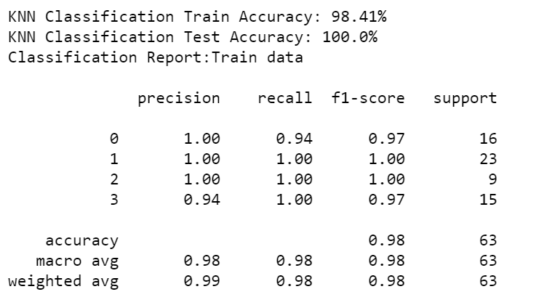
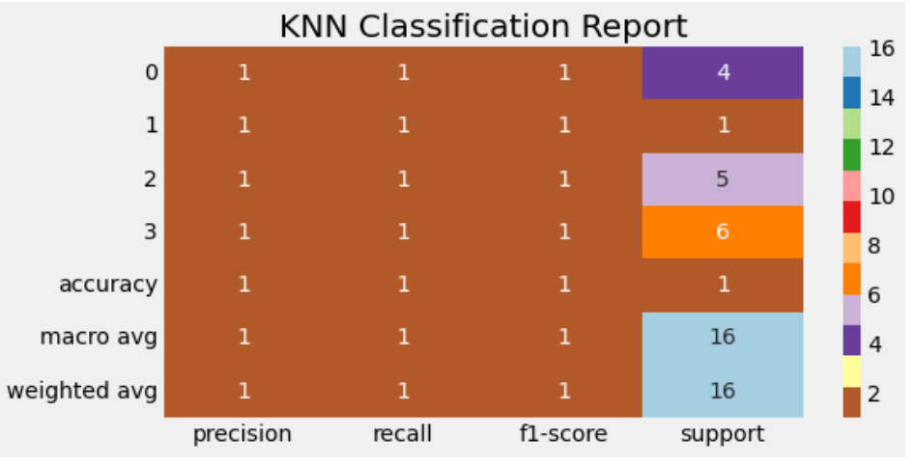
Model-Evaluation Report
KNN Classification :
Here, we have taken KNN Classification Model.
100% Accuracy, Precision, Recall and F1-score have been achieved.
No overfitting or underfitting has been found. All classes are classified correctly and no misclassification.

Slide 18
Thank you

